Slide 1


SAP UI5 & FIORI with OData TRAINING using BAS
Anubhav Oberoy
Day – 7

Slide 2

Agenda – Day 7
Expression Binding
Concept of Named Model
How to create Named Model
Aggregation Binding

Slide 3

Expression Binding
Expression binding : - When we bind an Expression ({= condition ? true : false}) with the property of a control rather binding value to a property, this is called expression binding.
If we need some calculation on model data or some sort of comparison, then expression binding is useful.
Syntax:
numberState = “{= ${path} > value ? ‘conditionForTrue’ : ‘ConditionForFalse’ }”
Use Case of Expression Binding
My Manager want to add a make salary field grayed(read-only) whenever the employee name is Anubhav.
If The Employee Name is Anubhav, Gray out Salary field.
Condition – if employee name = Anubhav
Outcome – make field gray out
Target – Salary field
Note: To use expression binding in our application we need to add line in the bootstrap code of UI5 in index.html
data-sap-ui-bindingSyntax="complex"

Slide 4
Concept of Named Model
Concept of named model comes into observation when we want to use more than one model simultaneously in one application. When we uses two model simultaneously the there are some conflicts arises in the application , as the second model we use will overwrite the data of the first model. So, here we use the Named Model
Creation of Named Model :
sap.ui.getCore().setModel(oModel2 , “Name of the model”) ;
For example :
sap.ui.getCore().setModel(oModel2 , “thanos”); here thanos is the name of the model
Binding using the Named Model:
So in binding we use this name, to bind the data from the named model we use modelName>path in binding syntax
For example:
“{thanos>/empStr/empName}” this will bind the name from thanos model.

Slide 5
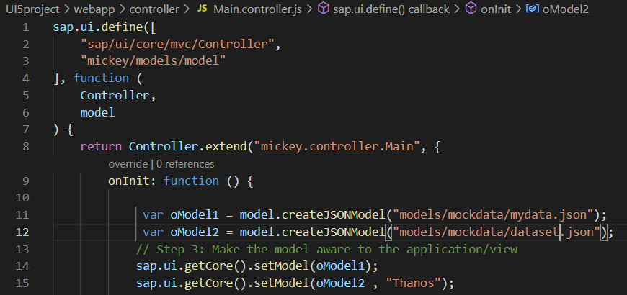
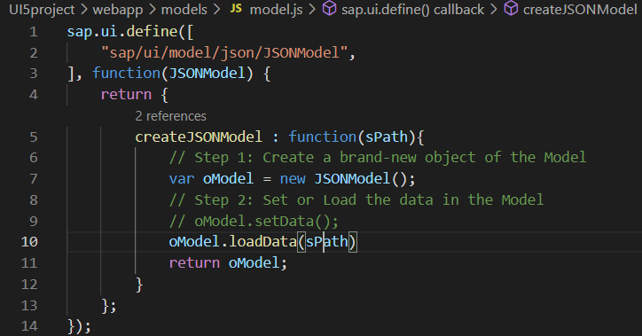
How to create a Named Model
In controller , we have to give the path in the createJSONModel() function
In model.js we have to get the path from the controller and the using that path we have to load the data using loadData() function
To bind the data we have to use the name of the named model.

Slide 6
Aggregation Binding
When we bind the aggregation of a control with the entityset of data model, it is called aggregation Binding.
The parent control (e.g. Table) is bound to the EntitySet path which is called absolute path and the child of the parent Control (e.g. Columns) are connected to the child properties of the EntitySet is called relative path.
In aggregation binding, based on your model data, as many child controls will be created automatically.
Every Event of UI5 will trigger the eventHandler and we will get the Event Object as part of the event Handler. Depending on the event, the event handler object will have different parameters.
Use Case of Aggregation Binding
If we want to show a list or some data in tabular format, we need to bind a group of data. In such a case we will use aggregation binding.
Absolute path
{
“empTab”: [
{
“empId”: 50,
“empName”: “Jay”,
“salary”: 9500
}
]
}
Table = {/empTab}
Emp Id | Emp Name | Salary
{empId} | {empName} | {salary}
Relative Paths

Slide 7
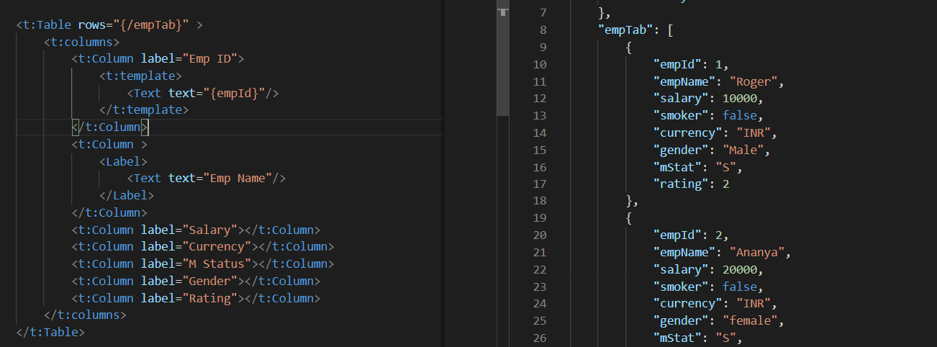
Absolute Path : Connecting parent to parent
Relative Path : connecting child to child respective to parent control

Slide 8
Title
Content

Slide 9

End of Day 7

Slide 10

Questions

Slide 11

Anubhav Oberoy

Slide 12


We’re committed to empower you to be
Most Desirable Resource
through powerful training solutions.
We build the workforce of the future.
250+
Corporate Clients
30,000+
Learners Trained
25000+
Learners Placed
FREE WEBINARS
Sign up for free webinars with industry experts every fortnight!
Enroll Now!
Contact us today!
https://anubhavtrainings.com/

Slide 13




More from AnubhavTrainings.com

Slide 14
Title
Content

